Slide 1
Narrative explanation of visualization encoding scheme
Wang, Qianwen

Slide 2
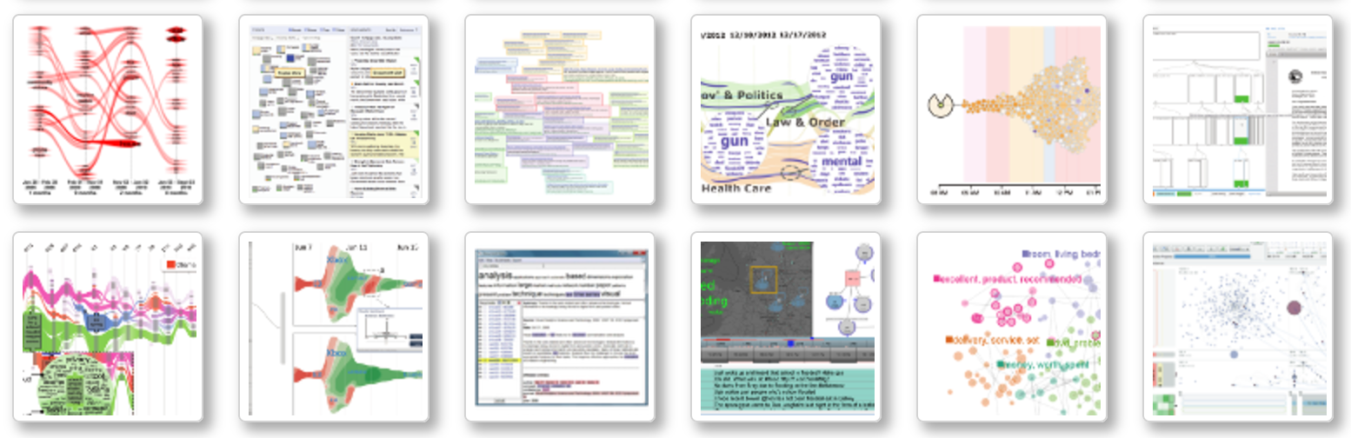
Motivation
Advanced visualization technology
Data with high dimension
Large datasets
Identify trends, similarities

Slide 3
Motivation
Advanced visualization technology
overwhelming information harm the understandability and memorability
Difficult to present, especially for novice
Little exposure outside visual community due to relatively long study period

Slide 4
Motivation
Why so difficult
_ the logic dependency of different logic encodings _ the visual distraction from context _ short term memory
_ inappropriate assumption that some visualization are universally recognizable

Slide 5
Motivation
Narrative explanation can be a solution!
Specify the reading order
Bring information density down
Pre-defined narrative templates
Less study burden
Increase understandability and memorability
Guideline for presentation
time
Spatial order
Templar order

Slide 6
Motivation
We present a narrative templates that
defines the logic flow of encoding explanation based on their logic dependency
applies animated transition to avoid the interference between channels of the same mark, applies blur, zoom-in/out to eliminate the distraction from context.
inserts memory recaller such as examples, quiz, summarization to remind audience what has been explained before.

Slide 7
Contributions
An authoring tool to generate narrative slideshow for visualization explanation
General audience:
a tool to understand advanced visualization technology
People inside visualization community:
An authoring tool to generate narrative visualization.
A guideline: how to present a visualization
A notebook: record how themselves digest this paper, facilitating later share and communication
Future application:
Embedded in online visual analysis system

Slide 8
Related works
Narrative techniques: sequence & attention guidance
Authoring tools for narrative visualization
Tools for understanding visualization

Slide 9
Related Works
In other field
And people apply it in visual community, develop it based on the data attribute
Logic sequence for narratives
logic | Paper | Useful Content | But…..
 | Visual Narrative Structure | Outline a narrative grammar of sequential images to explain how people make meaning of it. Such structure also permeate films and verbal discourse ,
 | A Deeper Understanding of Sequence in Narrative Visualization | A taxonomy of the transition (logic ) between visualizations Algorithmically Identifying Effective Sequences based on data attributes
 | Timelines Revisited: A Design Space and Considerations for Expressive Storytelling | a design space ( representation, scale, and layout ) and considerations for presenting timeline stories with the aim of balancing expressiveness and effectiveness.
 | Understanding Data Videos: Looking at Narrative Visualization through the Cinematography Lens | narrative structure of data video described the wide range of patterns used in data videos knowledge on the composition of narrative visualizations, identifying what makes them compelling or memorable
 | A Practical Iterative Framework for Qualitative Data Analysis | a loop-like pattern of multiple rounds of revisiting the data as additional questions emerge, new connections are unearthed, and more complex formulations develop along with a deepening understanding of the material.

Slide 10
Related Works
For attention guidance: focus + context, zoom in
For better understanding: morphing, highlight dynamic step by step
Animation in data visualization
Paper | Useful Content | But…..
Learning Visualizations by Analogy: Promoting Visual Literacy through Visualization Morphing | Morphing from familiar vis to unfamiliar vis | A theory, not a tool
Visualizing data with motion | Results suggest that a coherent flicker difference of at least 120 msec, a di- rection difference of at least 20◦, and a velocity difference at least 0.43◦ of subtended visual angle are needed to distinguish between different values of the three properties.
Graph Diaries: Animated Transitions and Temporal Navigation for Dynamic Networks | Dynamic network, highligh what is changed every step
Attractive Flicker: Guiding Attention in Dynamic Narrative Visualizations
Effectiveness of Animation in Trend Visualization
Visual Sedimentation

Slide 11
Related Works
Authoring tools for narrative visualization
Paper | Useful Content | But…..
Power point and keynote, less interactivity In Tableau, storytelling features are integrated using an annotated stepper interface called story point.
Temporal Summary Images: An Approach to Narrative Visualization via Interactive Annotation Generation and Placement
Stories in Geo Time
Authoring Data-Driven Videos with DataClips
SketchStory: Telling More Engaging Stories with Data through Freeform Sketching | Sketch-based interaction for real time storytelling
Authoring Narrative Visualizations with Ellipsis

Slide 12
New problem or old problem?
Old problem:
better understand visualization
New method:
The first authoring tool aiming to explain advanced visualization designs in the form of narrative slideshow

Slide 13
Analysis target: Text Vis
Data attribute:
Time, geo, sentiment, correlation, size/frequency, cluster
Dataset type:
Table, network, geometry
Common mark:
Node: a topic, a document, etc
Line: correlation, transition
Area: stream over time
Common vis techniques:
Node-link, tree, word cloud, Sankey graph, scatter plot

Slide 14
Analysis target: Text Vis
Rectangular coordinate | x | y
Scatter plot
matrix
Sankey diagram
Polar coordinate | radius | theta
Radial tree map

Slide 15
Analysis target: Text Vis
Visual unit | Is it the main visual unit
Stream graph
Tree graph
Radial diagram
Density map
Node based (node link, scatter plot, stacking nodes)
Text based (sentence tree, word cloud)
glyph

Slide 16
Analysis target: Text Vis
mark | encode | channel | encode
node | A document, a topic, a keyword, etc | hue | Category Sentiment
 |  | shape | Category
 |  | Luminance /saturation | Ordered attribute
 |  | Position | X-Y:
 |  |  | R-Θ:
 |  |  | Others:
 |  | size | Frequency of a topic, volume of a file, importance of a user, etc

Slide 17
Analysis target: Text Vis
mark | form | channel | encode
keyword | Word cloud, Sentence tree | color
 |  | size
 |  | position

Slide 18
Analysis target: Text Vis
mark | encode | channel |  | encode
line |  | color
 |  | Dotted/dashed/solid
 |  | Dotted intensity
 |  | width
 |  | Straight line | Source/target
 |  | Transition line | Y-position/layer
 |  |  | Transition begin/end
 |  | Curve | Path (curve )

Slide 19
Analysis target: Text Vis
mark | encode | form | channel | encode
area |  | Theme river
 |  | Radar chart

Slide 20
Narrative Structure
A visual atomic (e.g. a node with encoded color and shape)
Animated transition
(add one more channel)
Channel
X1
Channel
X1+ Y1
Channel
X1+ Y1+Z1
Channel
X3
Channel
X3+ Y3
mark A
mark A
mark A
mark B
mark B
mark C
mark C
mark C
mark C
Narrative sequence
A visual unit
(e.g. word cloud)
Attention guidance
(one visual atomic to another atomic, one visual unit to another unit)

Slide 21

Animated transition
mark:
line
channel:
color, y-position,
dot intensity, width,
Channels might disturb each other!
If I use this figure to explain the encoding of color, people might also wonder the encoding of width, dot intensity, etc, and thus are less focused

Slide 22
Animated transition
1990 1995 2000 2005 2010 2015

Slide 23
Animated transition

Slide 24
Animated transition

Slide 25
Animated transition

Slide 26
Animated transition

Slide 27
Animated transition

Slide 28
Animated transition

Slide 29
Animated transition

Slide 30
Highlight for attention guidance
Overview → an individual mark
One mark → another mark
Blur
Flicker
Zoom-in
Annotation
Motion

Slide 31
Highlight for attention guidance
Overview → an individual mark
One mark → another mark
Blur
Flicker
Zoom-in
Annotation
Motion
Good for marks with occupied area/ share same area

Slide 32
Highlight for attention guidance
Overview → an individual mark
One mark → another mark
Blur
Flicker
Zoom-in
Annotation
Motion
Attractive Flicker: Guiding Attention in Dynamic Narrative Visualizations
Application????

Slide 33
Highlight for attention guidance
Overview → an individual mark
One mark → another mark
Blur
Flicker
Zoom-in
Annotation
Motion

Slide 34
Highlight for attention guidance
Overview → an individual mark
One mark → another mark
Blur
Flicker
Zoom-in
Annotation
Motion
Good for glyph

Slide 35
Hypothesis
observe
Validate
User study: eye tracking
问卷
think aloud
Contribution:
Decompose algorithm: spatial->temporal
Logical flow: common bonding
Component
Extensive framework:
Semi-auto
Template:
Open frame work: template in template
Build in quiz/ repetition: multiple channel, text

Slide 36
Hypothesis --> validation
Automatic detect and decompose, build-in and user edit
Build in: pre defined template
Not build in: coordinate, mark, channel, layout, alg, example, quiz
Familiar, build-in →unfamilar,
Logic flow:
overview, 1,2,3; 1,2,1+2, 3;
Tool: text, transition, highlight

Slide 37
contribution
Observation, hypothesis, principle
Attomic visual component encoding
Logic path:
Tool: transition, high tlight, extensive
Extensive tool: other vis, online data analysis tool, save time

Slide 38
Highlight for attention guidance
Overview → an individual mark
One mark → another mark
Blur
Flicker
Zoom-in
Annotation
Motion
Good for an individual example

Slide 39
Narrative sequence
Overall Logical
Introduction, data type
Coordinate
Basic visual units decomposition
For each visual unit:
Markers: Node→ lines→ area Channels:
Nodes: Color→ Position→ Size
Algorithm to insert reminder, quiz, example

Slide 40
Narrative sequence
a infovis has 3 levels of structure:
a visual atomic: the combination of a mark and several channels
a visual unit: one or more visual atomics to completely present a data attribute
a info vis: the visualization we see.
Logic flow: From familiar to unfamiliar, from simple to complicate

Slide 41
Narrative sequence
The relationship between the channels of one visual atomic:
logic dependency → flow the logic

Slide 42
Narrative sequence
The relationship between the atomics of one visual unit:
logic dependency → flow the logic

Slide 43
Narrative sequence
The relationship between visual units:
share same visual encoding;
logic dependency;
unrelated

Slide 44
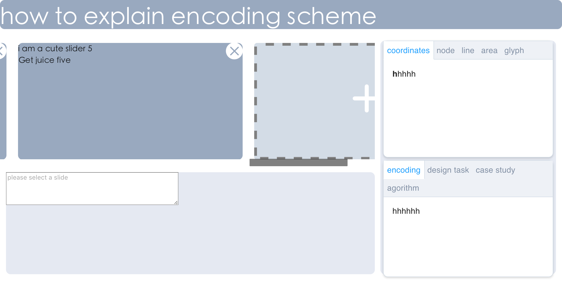
UI Design
Drag to add
Interactive slides:
Able to drag, delete, and add
Resource:
Extracted related elements from the text and the figure
Can be drag and drop on the interactive slides
Editor:
Edit selected slide
Add animation, edit annotation,

Slide 45
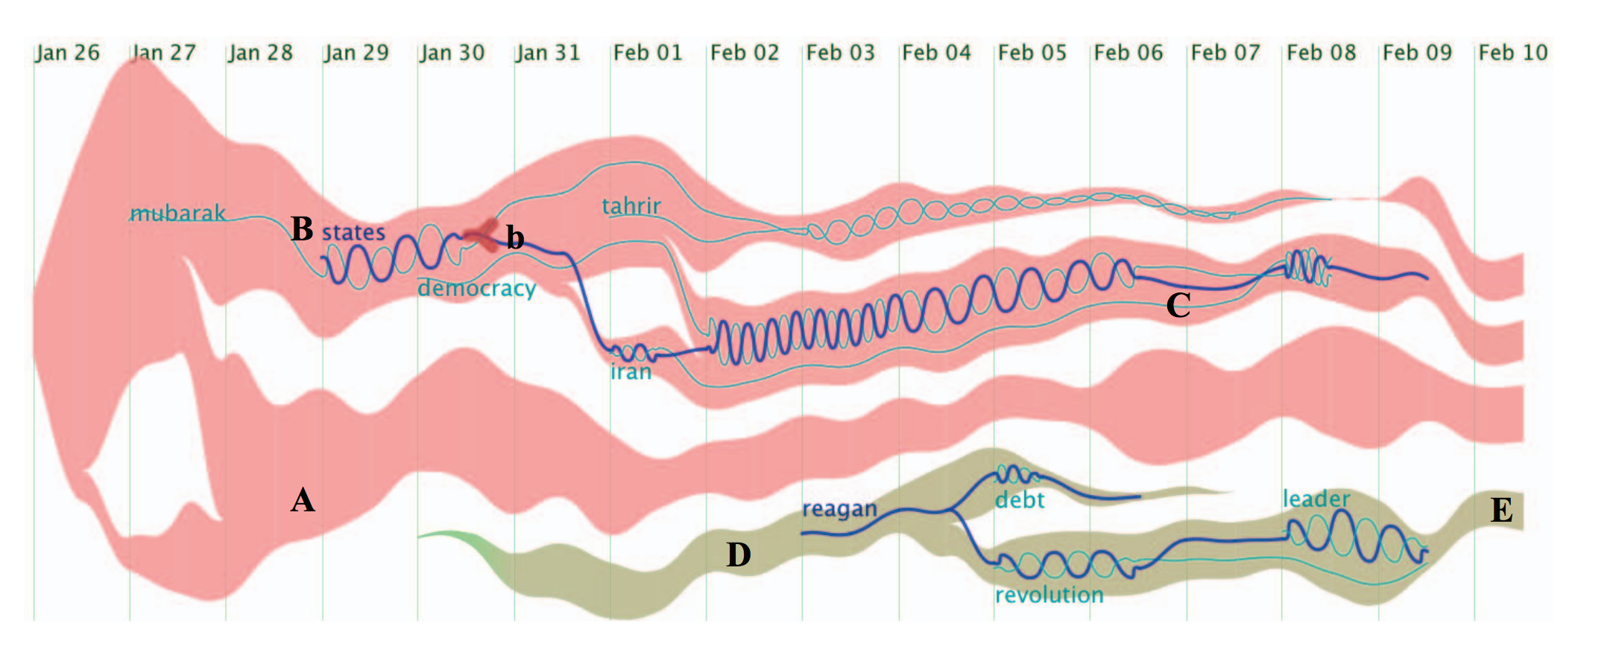

Case study: text flow

Slide 46
Case study: text flow
Data type:
individual topics with time stamped
connection between topics
tasks:
the topic evolution trend
the critical event
the keyword correlation
Visual unit:
Stream graph
Glyph
thread
Notes:
Step1:introduction
Use edit data type,
Design task,
visual units,
the relationship between visual units
The relationship between visual units and design tasks

Slide 47
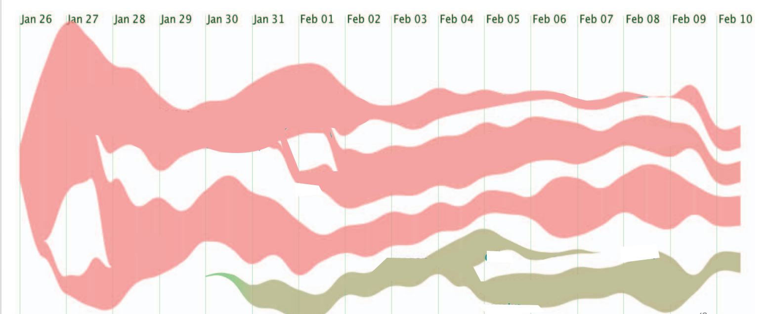
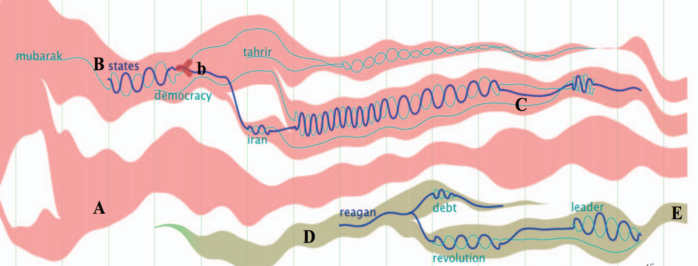
Stream graph
thread
glyph
Notes:
Step 2: visual units decomposition

Slide 48
Stream graph
thread
glyph
Notes:
Step 3: visual units explanation one by one following logic dependency
3.1: stream graph: build-in block available
3.2: glyph
3.3: thread

Slide 49
Stream graph
thread
glyph
Time line
Notes:
Step 3: visual units explanation one by one following logic dependency
3.1: stream graph: build-in block available
3.2: glyph
3.3: thread

Slide 50
Case study: text flow
Overview:
Visual unit:
Coordinate:

Slide 51
Case study: text flow
Visual unit 1

Slide 52
Case study: text flow
Visual unit 2

Slide 53
Case study: text flow
Visual unit 3

Slide 54
User study needed
Participants:
Insider VS outsider of visual community
Source:
Narrative slideshow of our system VS figures and text explanation
Metrics:
Understandability, memorability

Slide 55
Plan and milestone
date | idea | writing | coding | check
1.19 | Collect and read paper, videos about text visualization (start from theme river); | Survey related work;(wqw) | Finish decomposition of a png figure (LZ); Drag, add, delete of slides (WQW); | Code: ✓ Vis survey: Mainly focus on paper, need watch some video Related works: clarify categories, need to collect more next
1.26 | Summarize narrative templates; Show examples for feedback; | Related work collection | Collect all target visualization designs published in IEEE VIS, filter;(lz)
2.2 |  | Introduction and related work
2.9 | Refine the templates based on feedback; Continue survey and summarize; |  | Finish text and annotation extraction
2.16 |  | Narrative templates design | Online system: prototype
2.23 | User study design | Detection algorithm | Online system: interaction

Slide 56
Plan and milestone
date | idea | writing | coding | check
3.2 |  | 2 Case studies | Refine online system
3.9 | Experiment: user study
3.16 | Analyze user study data | User studies
3.23 |  | Conclusion and discussion
3.30 |  | Proof reading | Making video

